Slide 1
Compiler Design
Symbol Tables
Nadar Mispa Paulraj

Slide 2
Symbol table
The symbol table is used throughout the compiler to hold information about the various entities in the source program .
(classes, instances, methods, variables etc.) and their properties (types, arguments, visibility, memory requirement etc.).
This information is collected incrementally and used
by various phases of the compiler.

Slide 3
Components of Symbol Table
The symbol table you will build will have two main components
The Name Table
The Entity Table
The name table is used to uniquely identify different names that occur in the program.
each, entity in the program is represented by a unique entry in the entity table.

Slide 4
Symbol Table Operations
The two main operations are
insert (name) makes an entry for this name
lookup (name) finds the relevant occurrence of the name by searching the table
Lookups occur a lot more often than insert

Slide 5
More Symbol Table Functions
In addition to lookup and insert, the symbol table will also need
initializeScope (level) , when a block is entered to create a new hash table entry in the symbol table list
finializeScope (level), on block exit put the current hash table into a background list

Slide 6
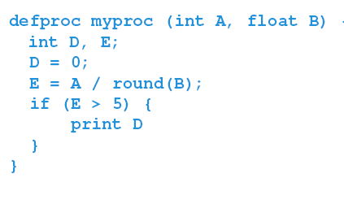
Given sample program to compile: lets see how symbol table is generated

Slide 7
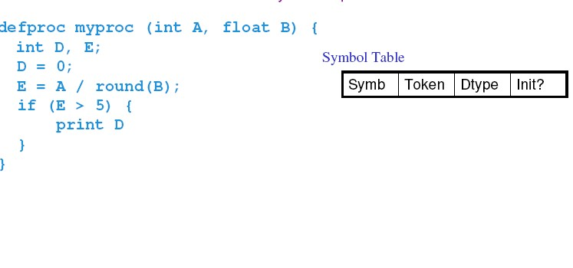

Slide 8
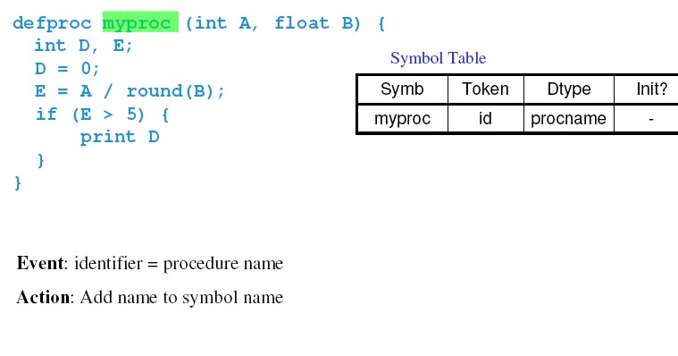

Slide 9
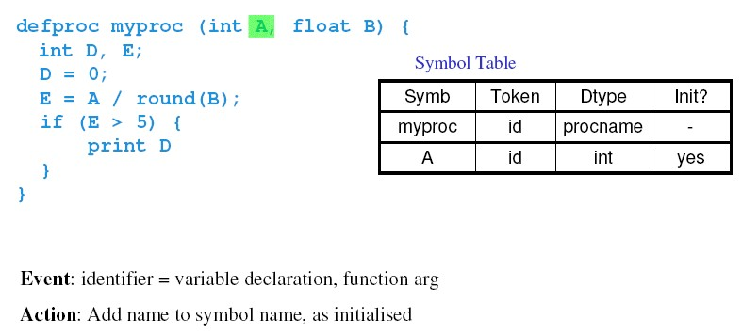

Slide 10
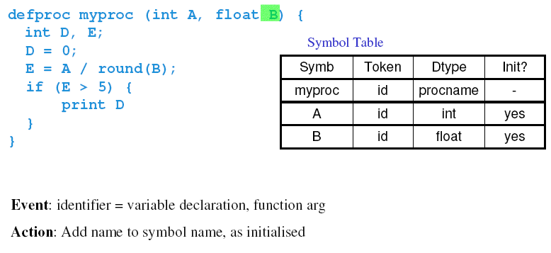

Slide 11
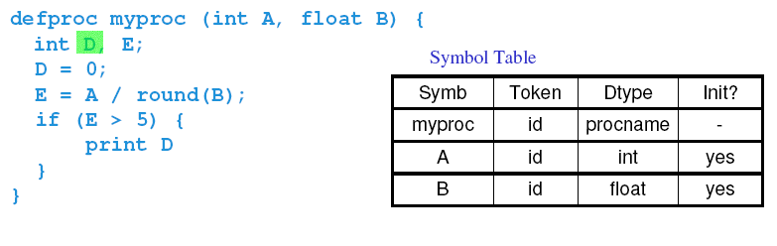

Slide 12
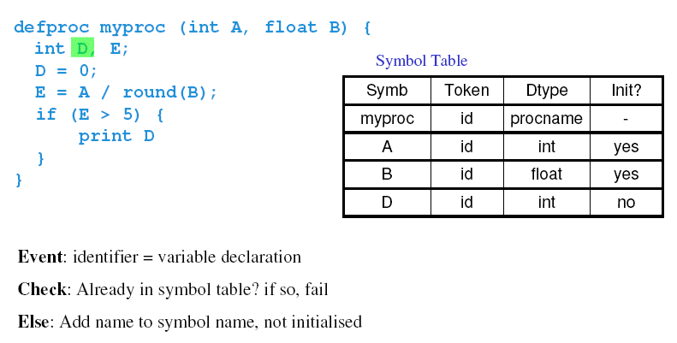

Slide 13
Thus ,
The Symbol Table Shows
How far the given program is compiled and stored in the table.
Entire program is transformed into a table

Slide 14
Thank You

